Slide 1



Python Fundamentals
Innovation Masters
Day 11

Slide 2
Today’s Agenda
We are almost at the end. Next class we’ll make Tic-Tac-Toe
Review Lists
Learn how to make methods
Practice methods
Scratch
Tech Talk

Slide 3
Lists in programming
You can visualize a list as a box with compartments
Syntax of declaring a list
my_list = [1, 3, 7] my_list = [ ] (can be empty too)
Each of the object has an index number, like we have for strings.
Do not store data/objects of different types together. Python allows you to do so but don’t do it.
Name
Data

Slide 4
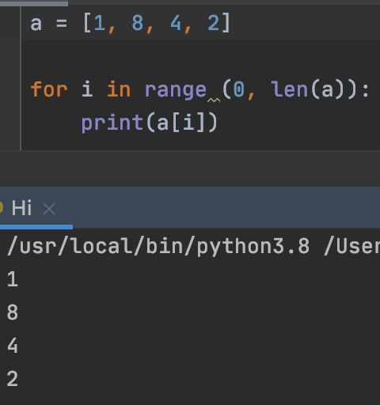
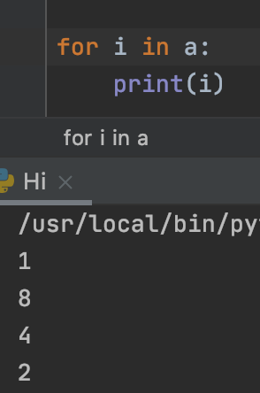
Iterating over a list
len(my_list) – how many objects are stored in the list
We can use for loops to iterate lists

Slide 5
Methods
Basically, methods are nothing, but several lines of codes bunched together.
They are used to repeat code, to make debugging easier, to make programs shorter and more readable, and also helpful for future use.
They have a few components like variables: name, body, parameters, return value

Slide 6
Analogies and examples
Car accelerator
Sit! Dog
A method simply contains some instructions for doing some work, and when we call/invoke the method, it does its job
It might ask for some input or might not

Slide 7
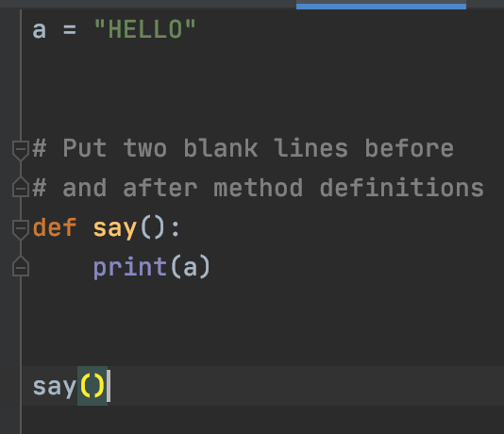
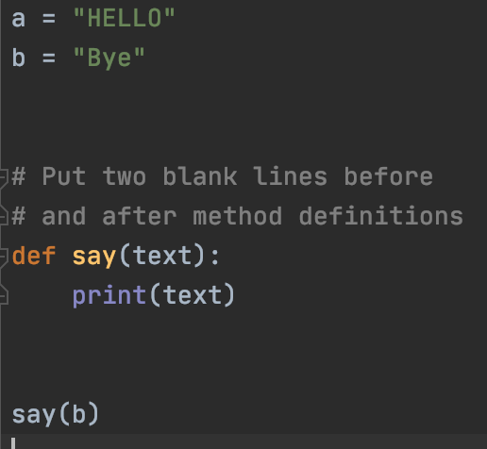
Syntax of methods
HELLO
Bye

Slide 8
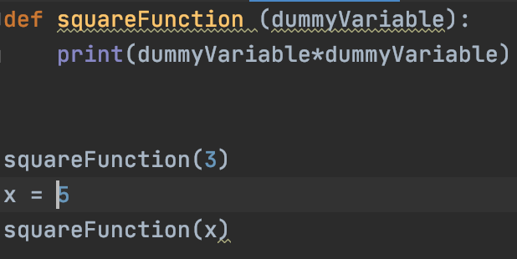


Another example
Name
Parameter
Original value of x does not change because we did not update value of x
Body

Slide 9
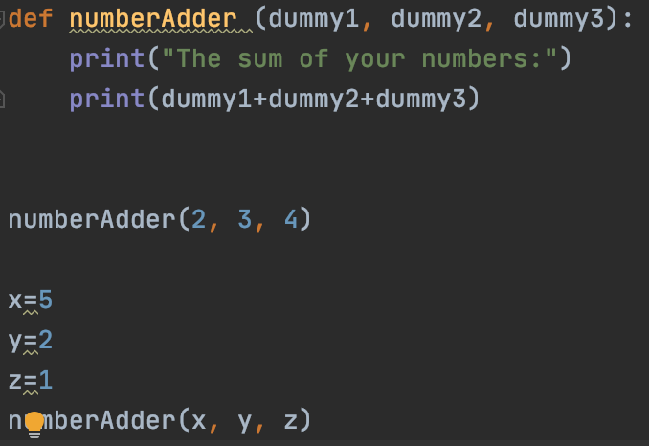
As many parameters as you need
You can add as many parameters as you need
You should follow the same naming conventions as we did with variables.
5, 2, 1

Slide 10
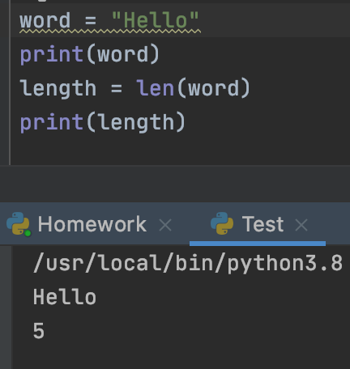
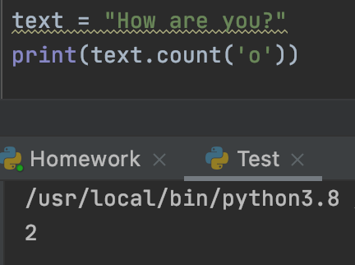
Some methods that we used already

Slide 11
Helping London Friend
Your friend from London has come and you guys are buying a chess set. On Amazon there are many different sizes to choose from. Only problem is all the sizes are in inches, but your friend only knows centimeters.
You have to make a method that takes in user input in inches and converts that to centimeters.
1 inch = 2.54 cm

Slide 12
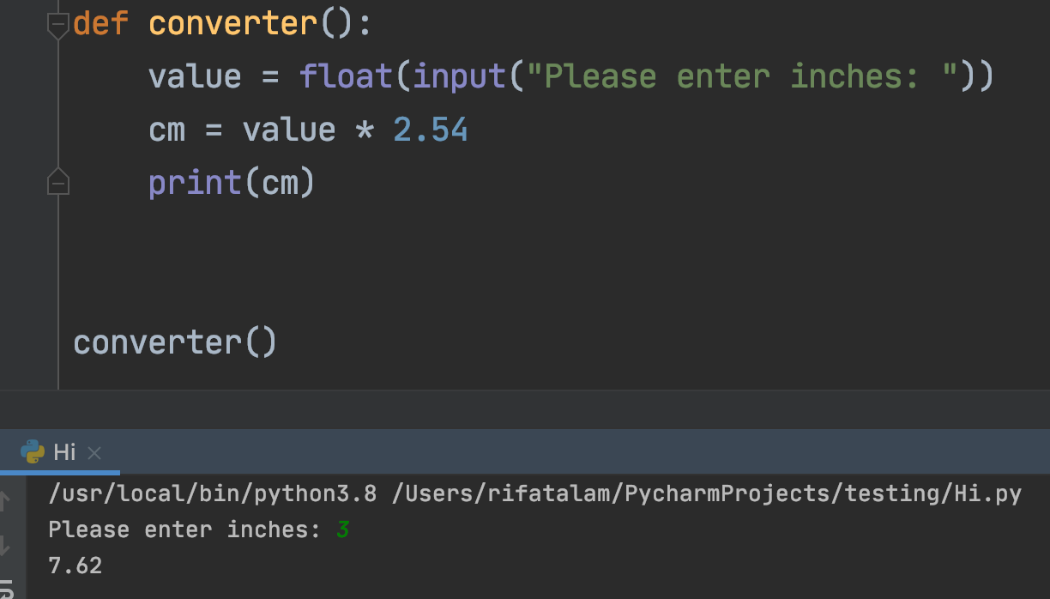
Solution

Slide 13
Another practice method
One of the teachers in your school, Mr. Dobby, has graded one of his tests. He wants to know what was the lowest score, highest score, and what was the average. Can you help Mr. Dobby find these statistics?
Make a method that takes a list as a parameter and find the minimum number, maximum number, and the average.
Print the answers nicely

Slide 14
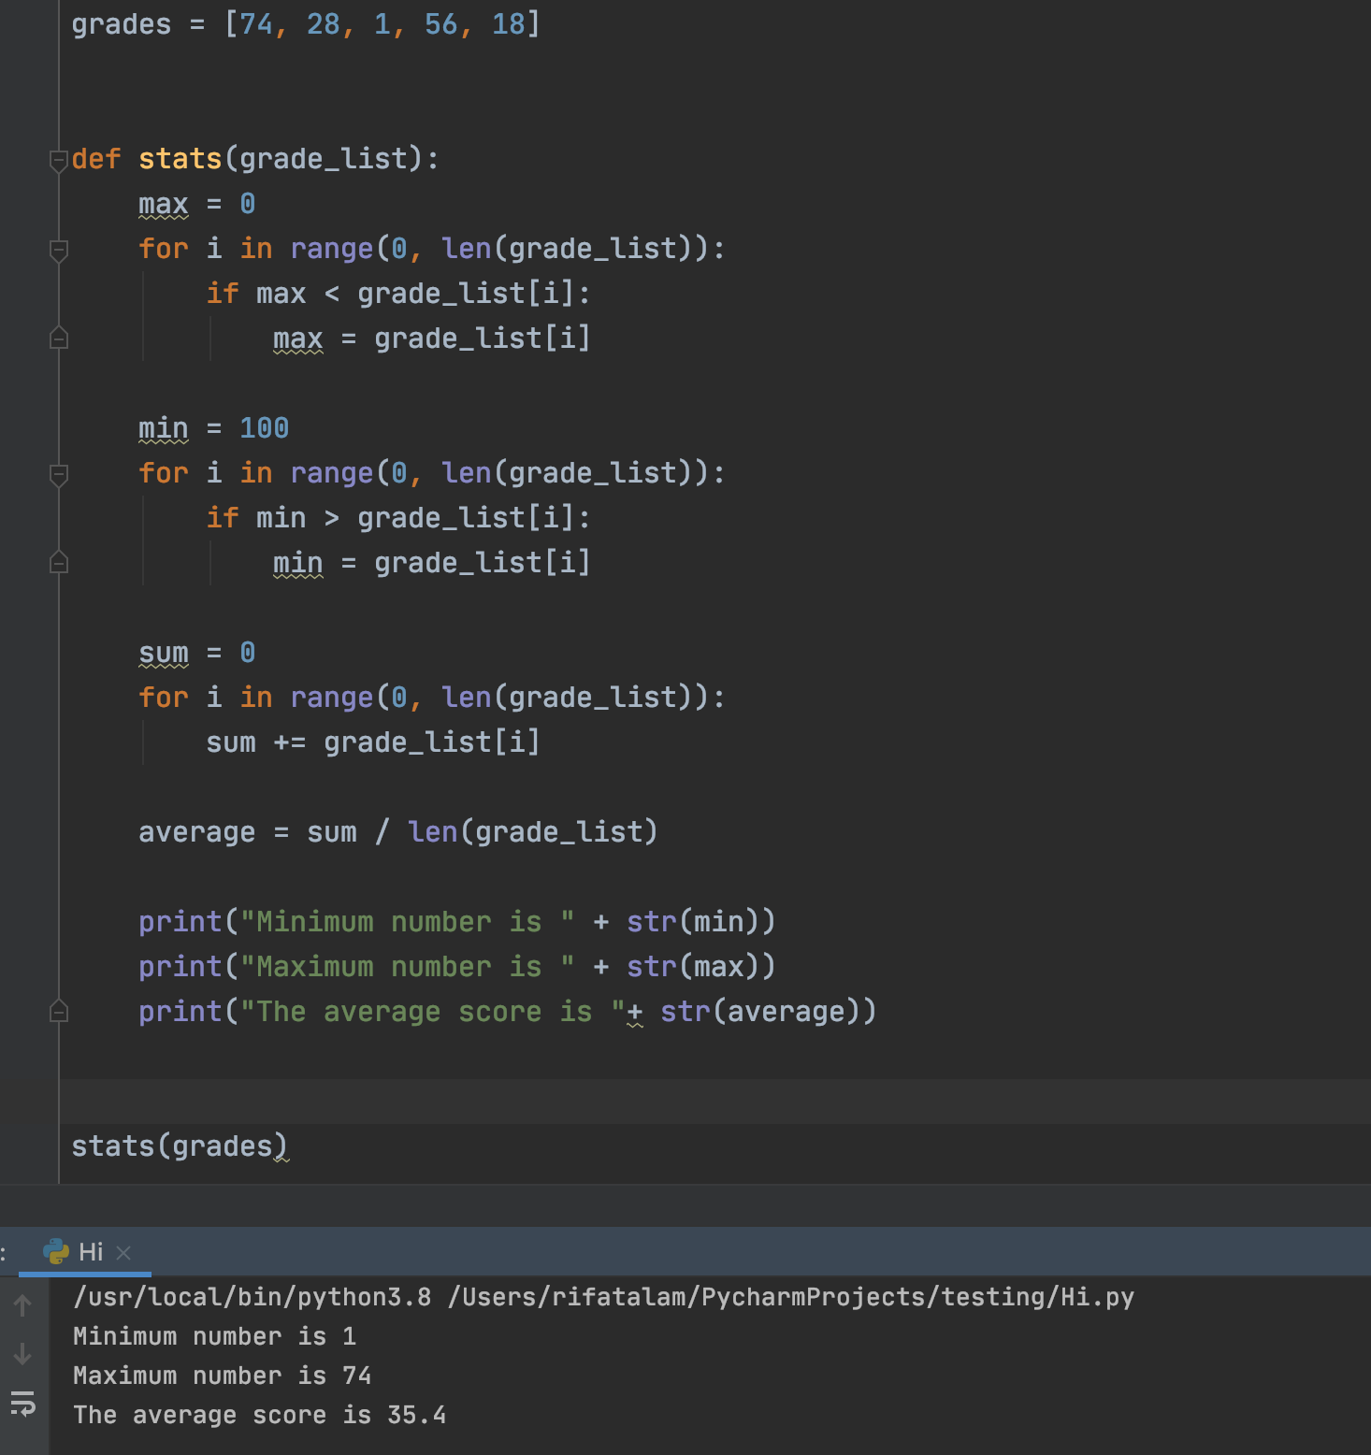

Slide 15
Method return
Your method could either be lines of instruction or have a final answer to return
If there is no final answer to return, we call it a void method. Or else we call it int, string, etc. method, depending on what value is returned
Difference between void and a return type method is only at the very end where we return something. Everything else is same.

Slide 16
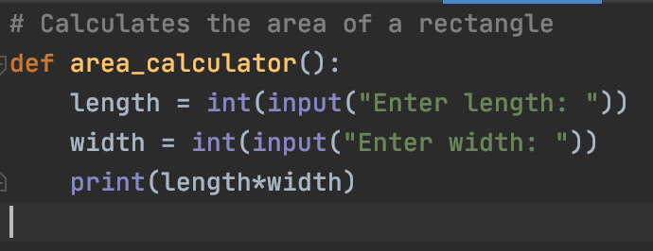
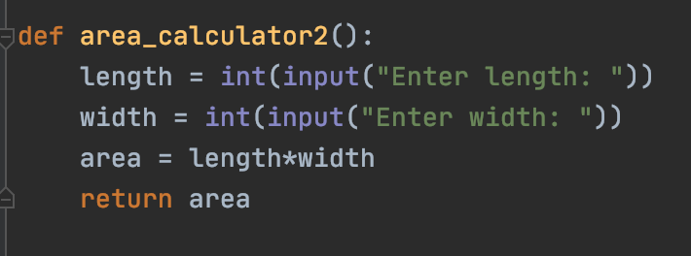
Examples
“int method” or method with int return type; could be double based on input
Void method

Slide 17
Continuing
When a method returns a value, that needs to be stored in a variable if you want to use in the future.
Usually, you would either assign the return value to a variable, or print it, depending on what the program needs.
A void method does not return any value. It simply does what is coded in its body.

Slide 18
Scratch and Tech Talk
https://www.youtube.com/watch?v=9WJliNDkXco&t=204s

